Slide 1

The CMMC Fledge System
Project Manager: Connor McFarren

Slide 2
Topics
Background Information on CMMC and the CMMC Fledge System
Progress so far
Quick Look at Website Statements
Storyboard
System Diagrams
Next Steps

Slide 3
Background
What is CMMC?
The Cybersecurity Maturity Model Certification (CMMC) is a DoD compliance framework. It utilizes the NIST 800-171 standard.
Why is CMMC important?
Starting this year and until 2028 CMMC is being rolled out as an mandatory requirement for organization to contract with the DoD and other parties.
DoD contracts are lucrative and critical to many businesses
How do organizations start the CMMC process?
Many organizations reach out to companies that offer pre-assessment engagements
These are expensive
Some organizations try to start process themselves
This is time consuming and very convoluted

Slide 4
What is CMMC Fledge?
The CMMC Fledge System will try to fix the gap within the market
The CMMC Fledge System will allow organizations to take a quick assessment to see where they stand
At the end of the assessment the CMMC Fledge will provide next steps and show potential gaps in the organizations current system

Slide 5
Progress
CMMC research completed
Website statements partially drafted
Storyboards drafted
System diagrams drafted

Slide 6
Quick Look at Website Statements
Click Here

Slide 7
The CMMC Fledge System Storyboard

Slide 8
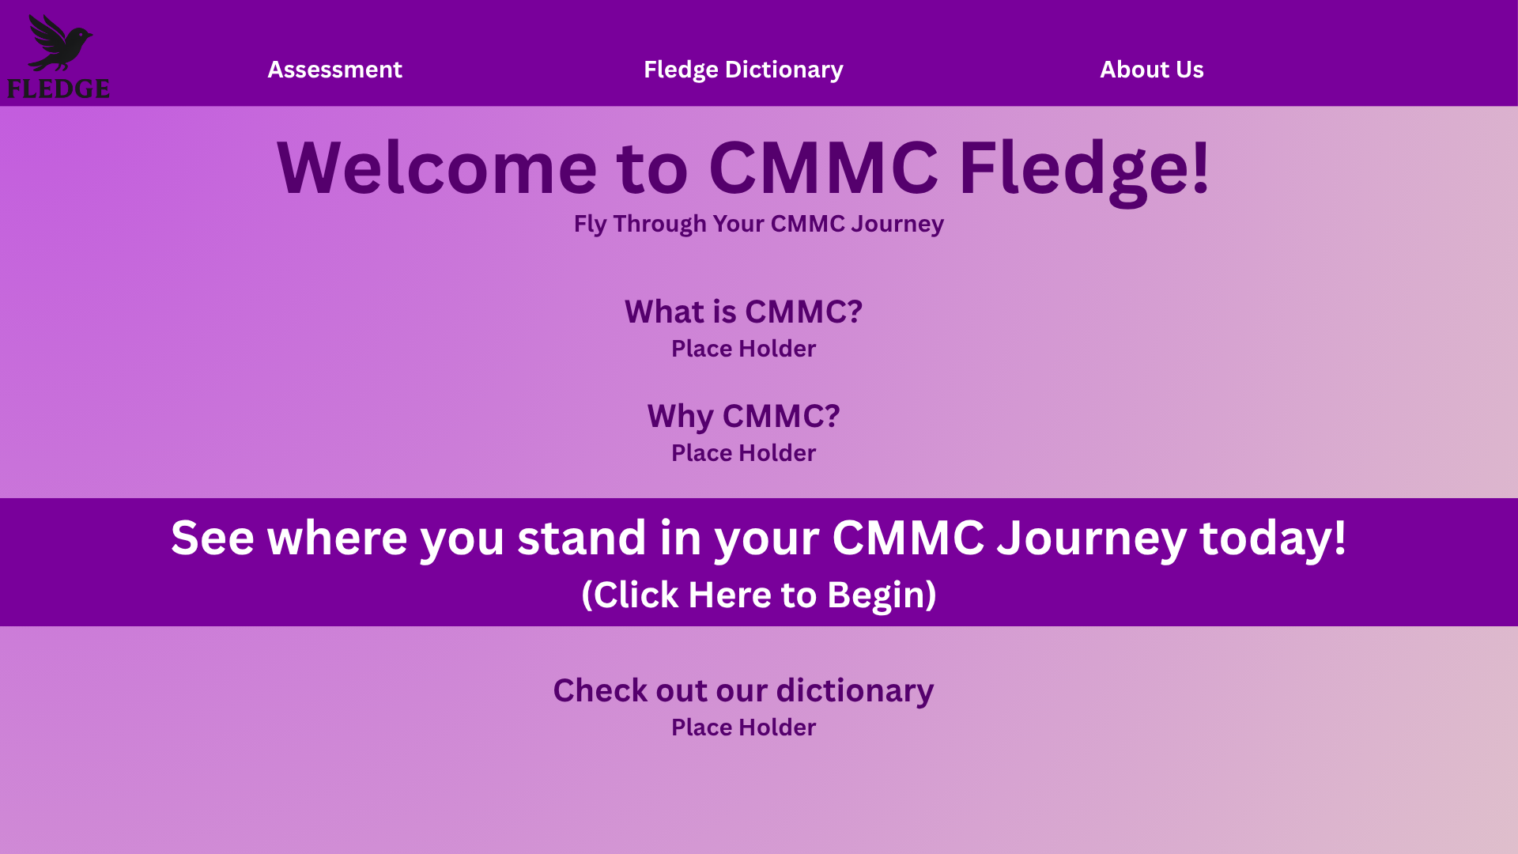

Slide 9
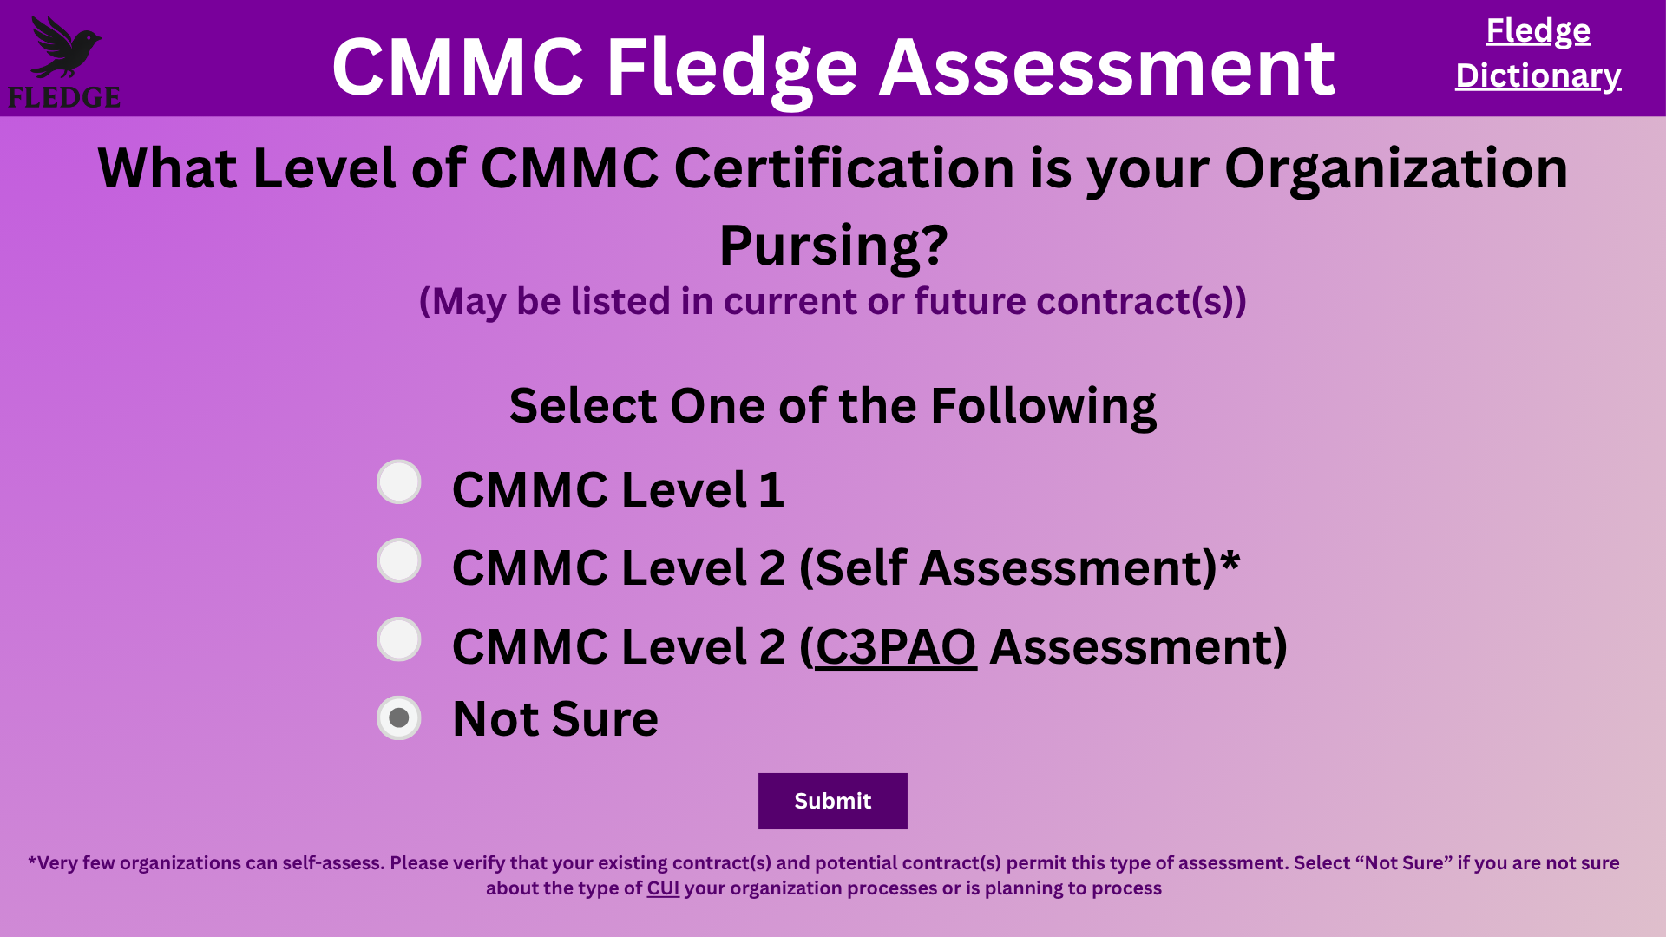

Slide 10
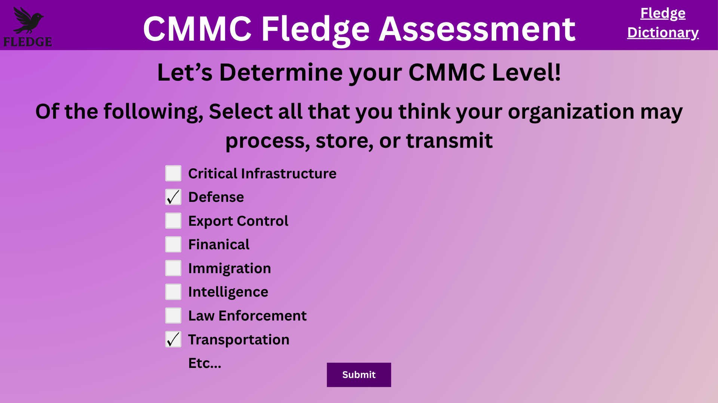

Slide 11
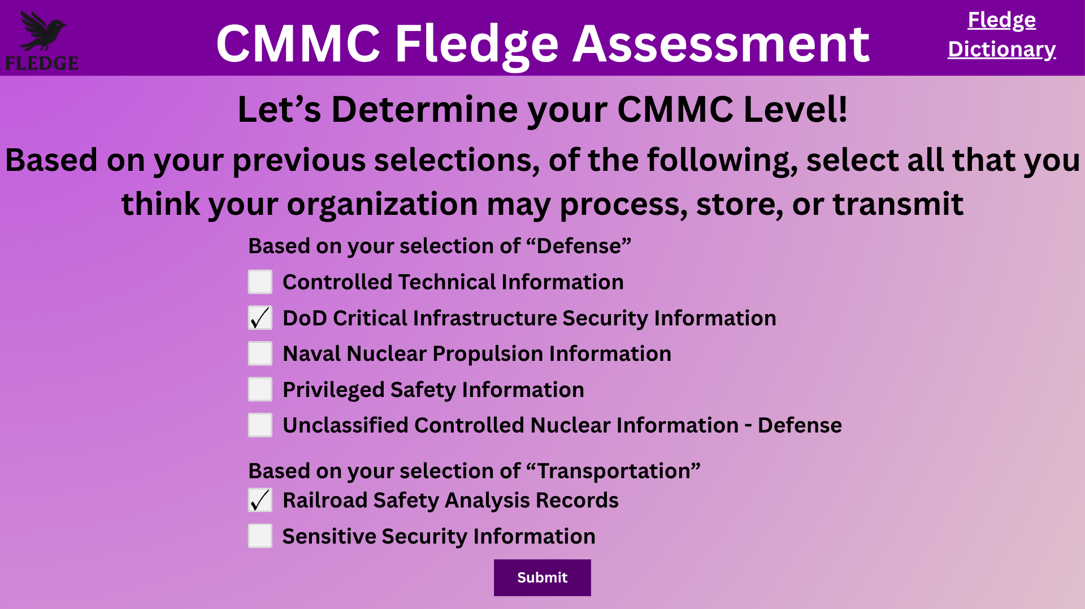

Slide 12
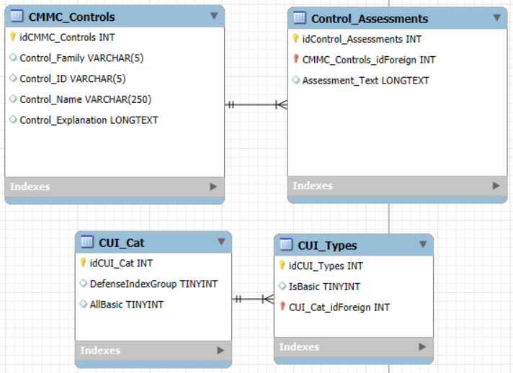
Database ERD

Slide 13
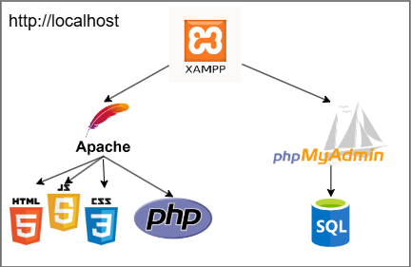
Development Technologies

Slide 14
What’s Next?
Starting the implementation (XAMPP)
Finishing all statements for all pathways
Create AWS environment

Slide 15
Questions?

